Slide 1
MATLAB Programming
Lab
Instructor: 黃世強 (Sai-Keung Wong)

Slide 2
About demo video and demo programs.
A demo video or a demo program may have bugs. They show or illustrate roughly the results. These results may not be exactly the same as the requirements. They are for your own reference. You must follow the instruction to finish your programs.

Slide 3
About Program Parameters
Please try different parameters to see the outcomes.

Slide 4
File content header
At the top of the file, write down your name, ID, email address, department, and date. If you do not do so, you receive a score of zero in the corresponding problem.
%%%%%%%%%%%%%%%%%%%%%%%%%%%
% Midterm Number: …
% Problem number: …
% Student Name: …
% Student ID: …
% Email address: …
% Department:
% Date: ….
%%%%%%%%%%%%%%%%%%%%%%%%%%%%

Slide 5
File content
For each problem, display the problem number before showing the results.
close all; clear; clc; % close all windows
% clear variables, and clear screen
disp(‘Lab Problem 1.1') % show Problem 1.1

Slide 6
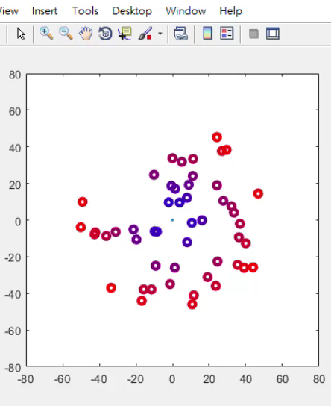
Problem 1.1. “Galaxy” system.
There are a particle fixed at center [0 0].
There are (free) particles moving around the center particle.
Color interpolation is adopted to color the colors of the free particles.

Slide 7
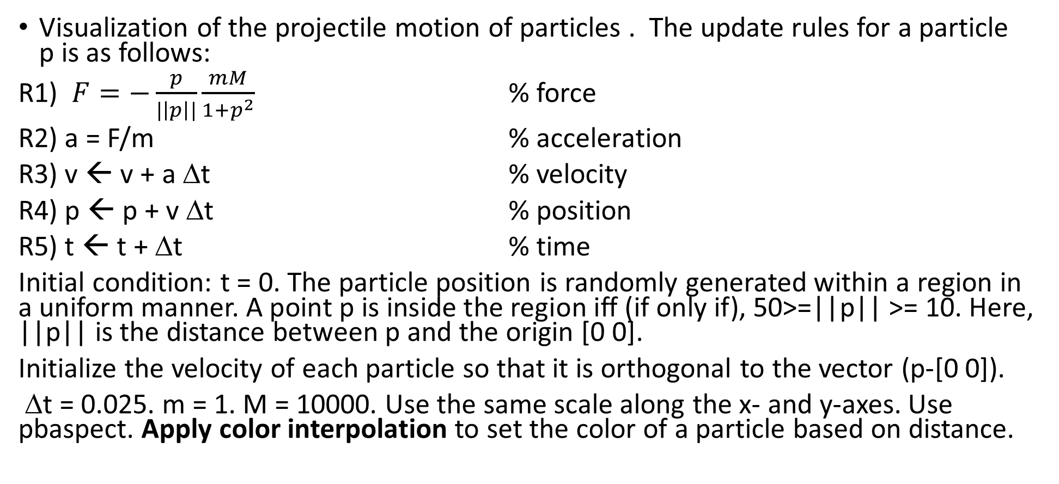
Problem 1.1. “Galaxy” system.
Visualization of the projectile motion of particles . The update rules for a particle p is as follows:
R1) $F=−\frac{p}{|\left|p\right||}\frac{mM}{{1+p}^{2}}$ % force
R2) a = F/m % acceleration
R3) v ← v + a Δt % velocity
R4) p ← p + v Δt % position
R5) t ← t + Δt % time
Initial condition: t = 0. The particle position is randomly generated within a region in a uniform manner. A point p is inside the region iff (if only if), 50>=||p|| >= 10. Here, ||p|| is the distance between p and the origin [0 0].
Initialize the velocity of each particle so that it is orthogonal to the vector (p-[0 0]).
Δt = 0.025. m = 1. M = 10000. Use the same scale along the x- and y-axes. Use pbaspect. Apply color interpolation to set the color of a particle based on distance.

Slide 8
Problem 1.1
Play it to see the animation
Velocity normalization. Make the velocity of the particle p orthogonal to the vector p – [0 0].
Assume p = [x y]. Then the velocity is
A) s * [y -x] /||p|| or
B) s * [ -y x]/||p||
Set s to 20. If you adopt the same rule (A or B) to set the velocities of all the particles, all the particles rotate in the same direction.
Color interpolation. The color of a particle depends on the distance, d, of the particle to the origin [0 0].
The color is computed as follows:
cp0 = [ 0 0 1]; %blue
cp1 = [ 1 0 0]; % red
vD = min(1, d/50);
particle_color = cp0 + vD*(cp1-cp0);

Slide 9
Problem 1.1
The major steps:
Ask to input the number, n, of particles: [0, 300].
If n is zero, show the student ID and quit the program.
Show a game play message as follows:
This system generates n particles. Enjoy the simulation.
4. Perform the simulation until CTRL-C is pressed.
Note: In Step 3, the actual number of n must be shown. For example, if you enter 135 for n. Then the message must be:
This system generates 135 particles. Enjoy the simulation.

Slide 10
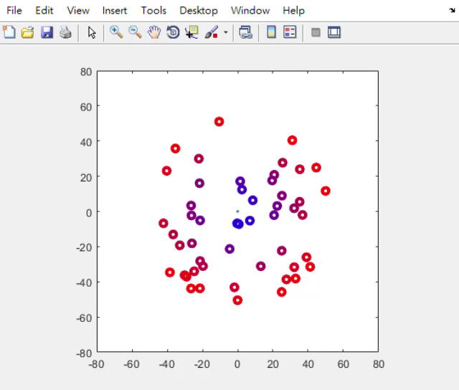
Problem 1.1
This demo shows that the particles do not rotate about the origin in the same direction.
You can set them in any way.
But the initial velocities of the particles must orthogonal to (p – [0 0])

Slide 11
End
Enjoy MATLAB Programming.

